Slide 1

X-PREX Tour
Michael Laufer and Grant Buster
Thermal Hydraulics Laboratory
Spring, 2015

Slide 2
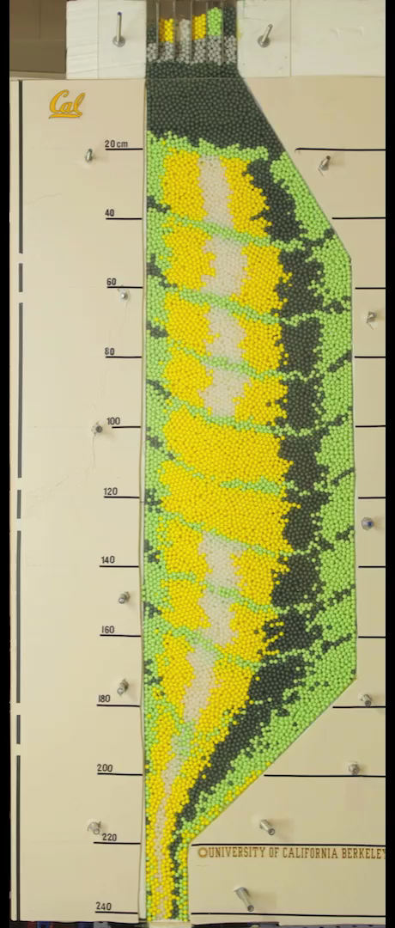
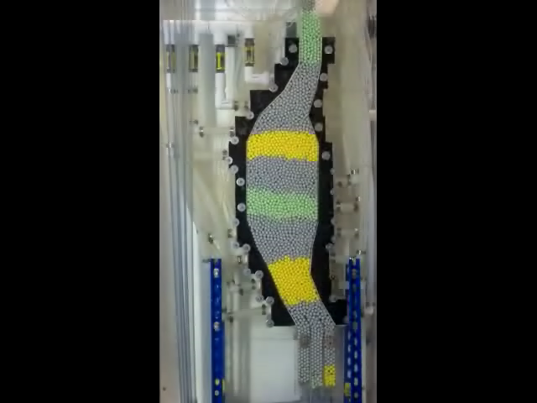
PREX: Pebble Recirculation Experiment

Slide 3
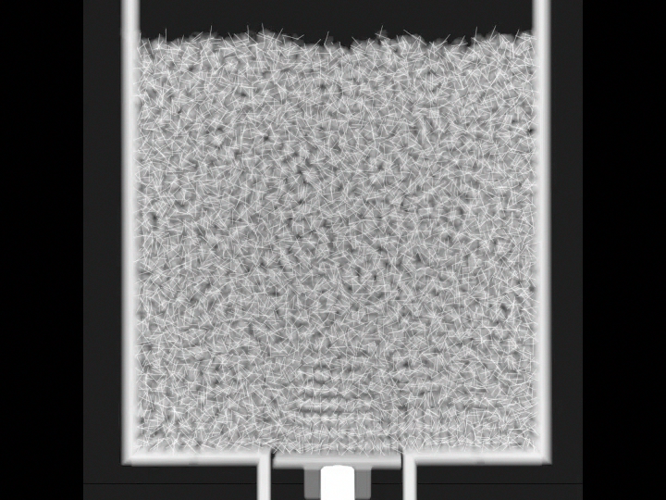
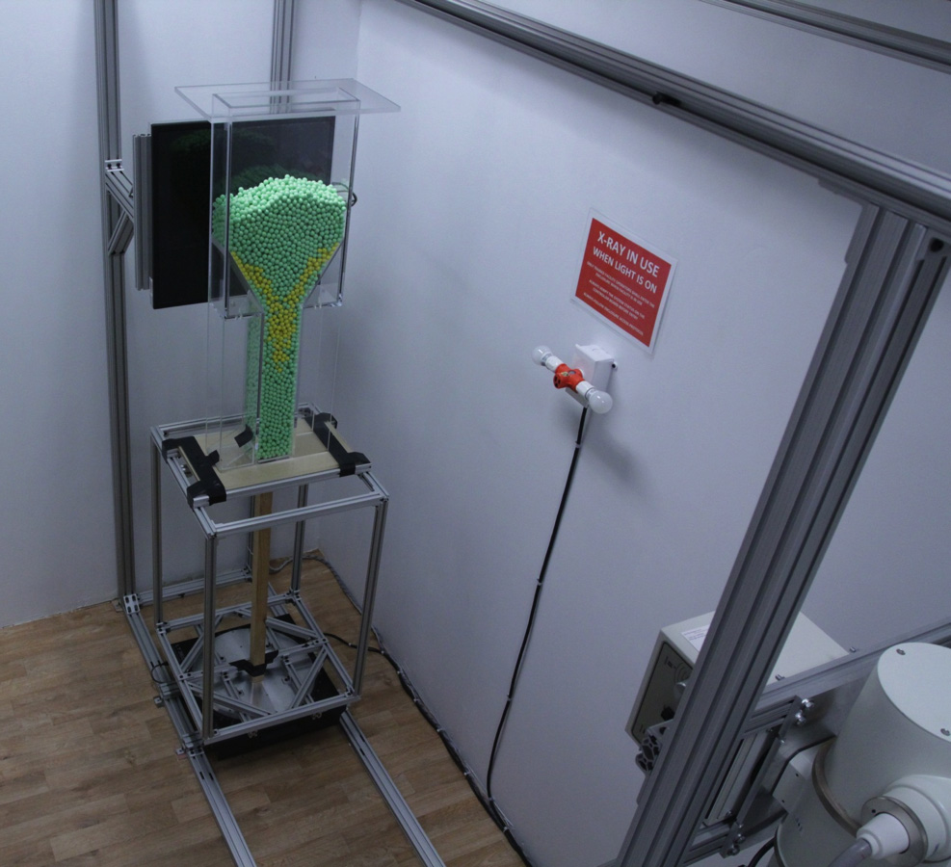
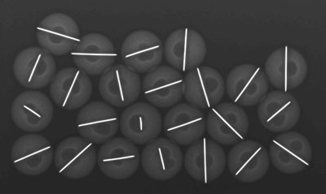
XPREX: X-Ray Pebble Recirculation Experiment
X-PREX Facility
Instrumented Pebbles

Slide 4
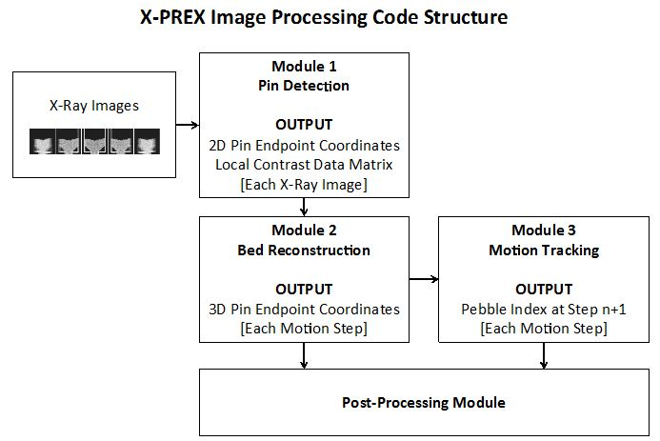
Image Processing Code Structure

Slide 5
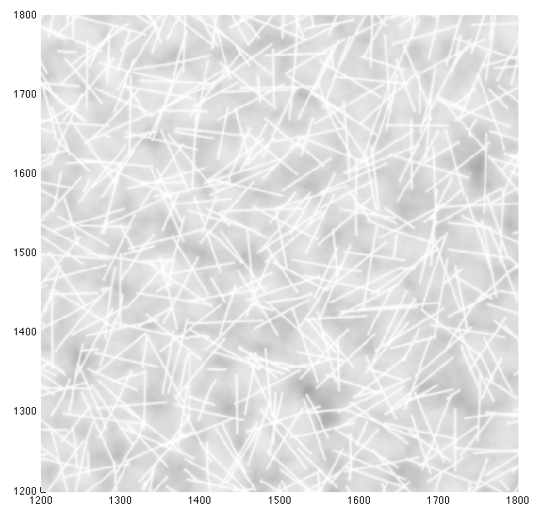
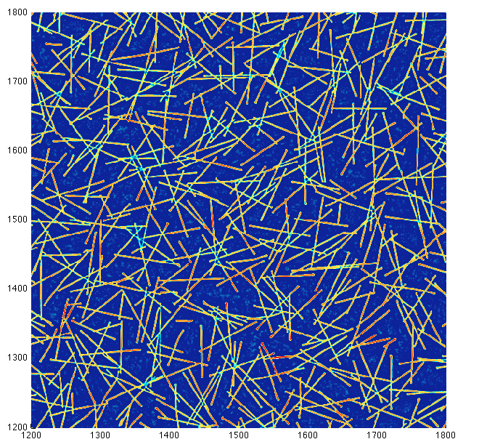
Module 1: 2D Image Processing
X-Ray Image
Local Contrast Data

Slide 6
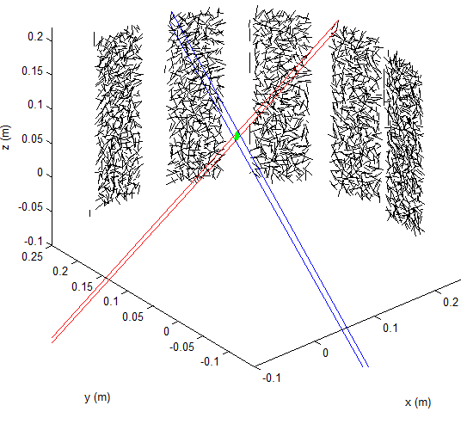
Module 2: 3D Pebble Bed Reconstruction

Slide 7
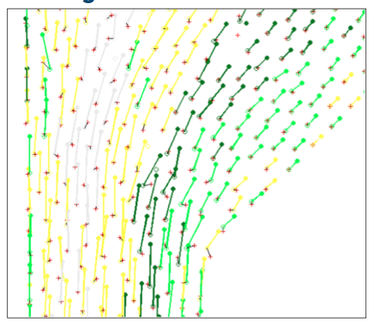
Module 3: Far Field Tracking

Slide 8
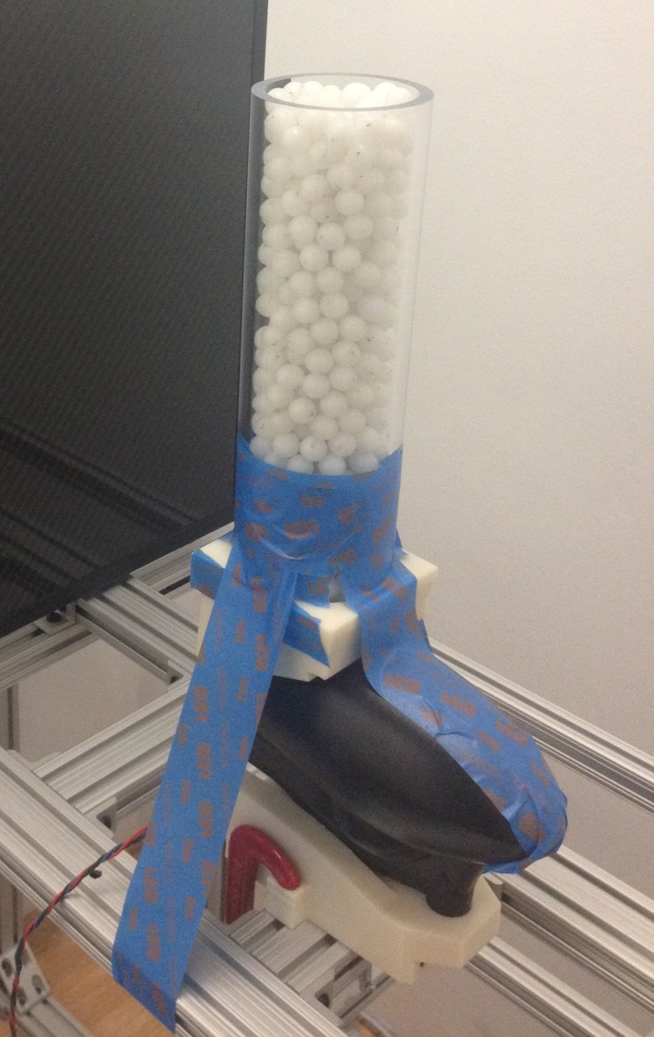
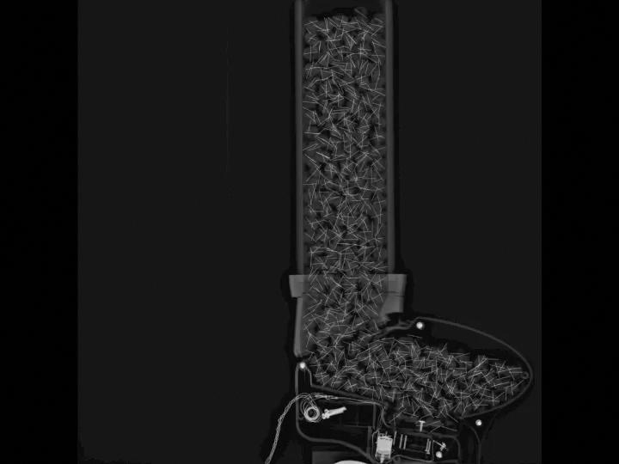
Image Processing Verification Test

Slide 9
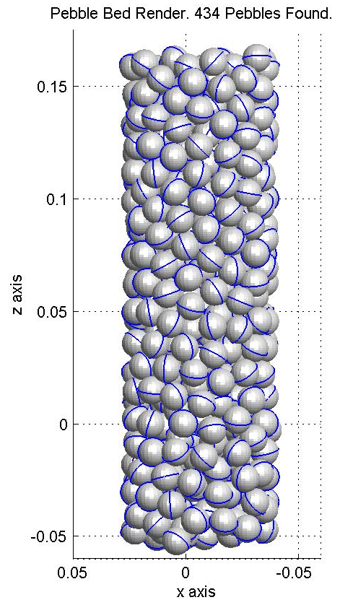
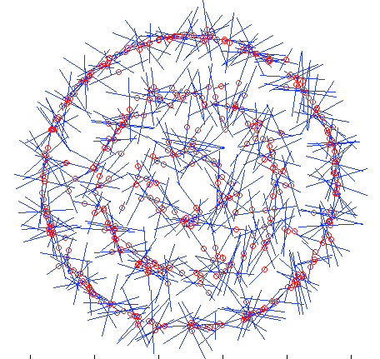
Image Processing Verification
Top View

Slide 10
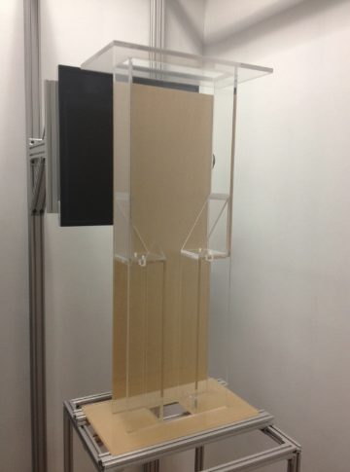
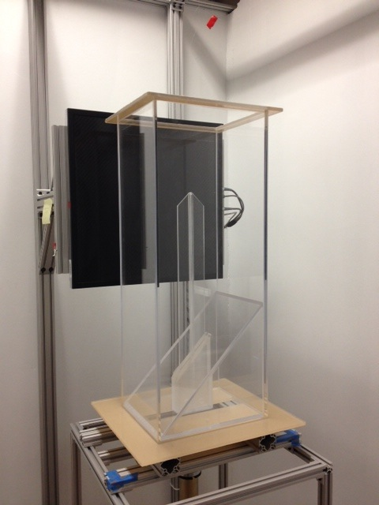
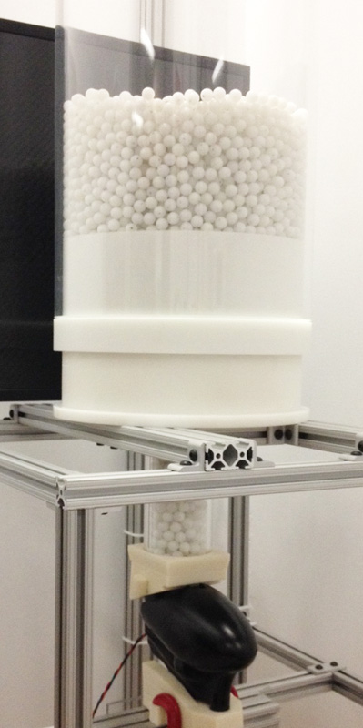
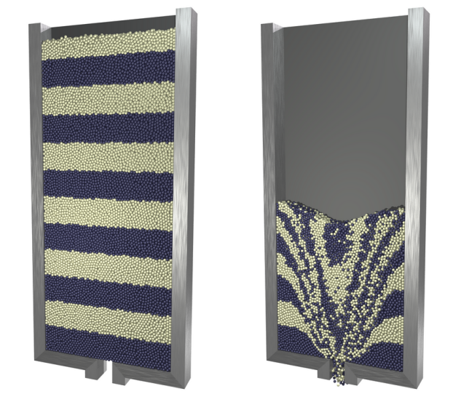
X-PREX: Facility Test Program
Dry Quasi-2D Silo
Control Blade Insertion
(CoBIE)
Dry Cylindrical Hopper

Slide 11
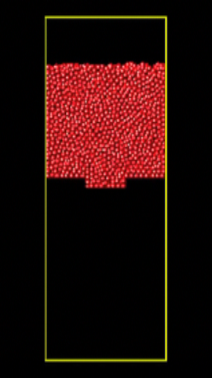
DEM Validation: Flow Visualization
X-PREX Image Sequence
DEM Simulation

Slide 12
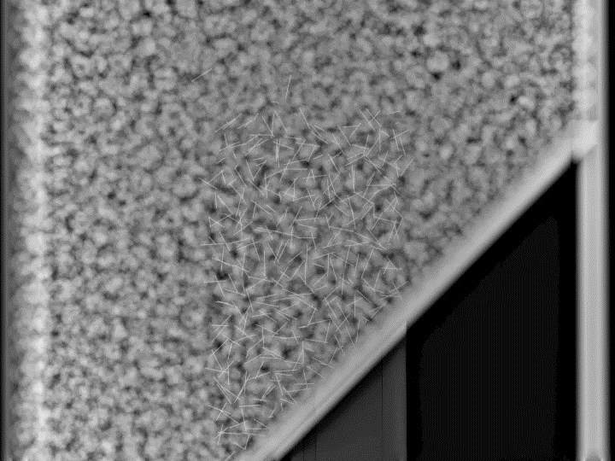
The Control Blade Insertion Experiment (CoBIE)

Slide 13
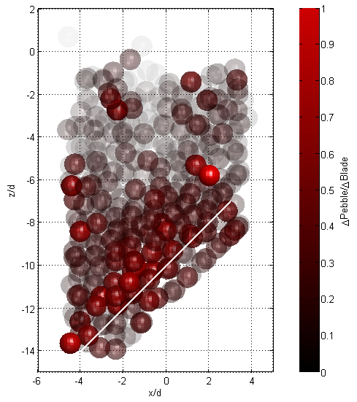
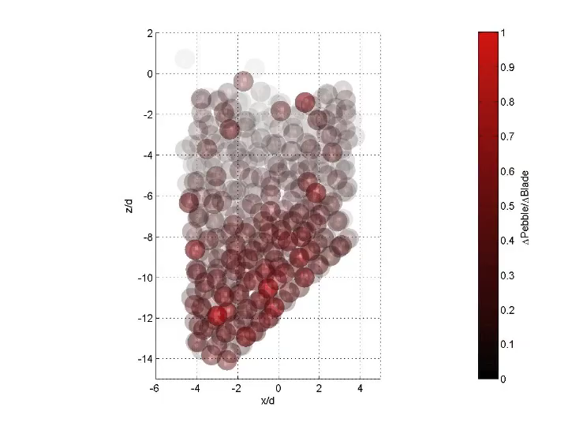
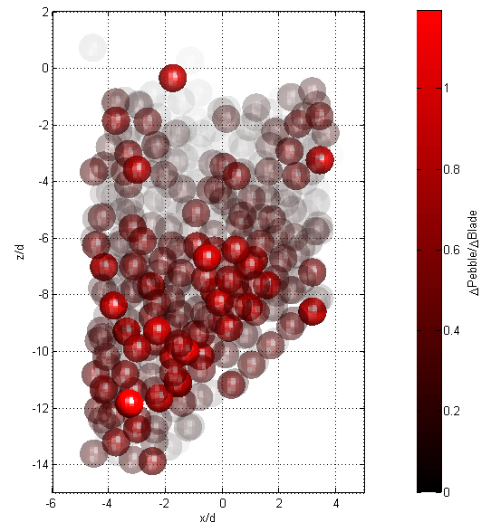
CoBIE Tomography

Slide 14
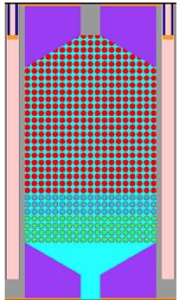
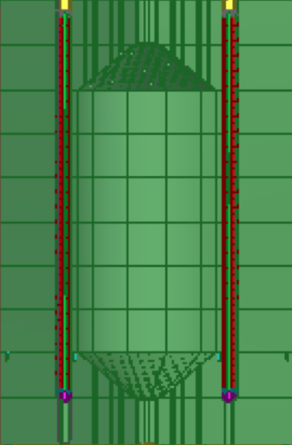
TMSR-SF1 Geometry Studied in X-PREX
SINAP Random Bed TMSR-SF1
Parameter | TMSR-SF1 | X-PREX
Thermal Power | 10 MW | --
Number of Pebbles | Start: 10950 Full: 14650 | Start: 10950 Full: 14650
Core Outer Diameter | 135 cm | 28.6 cm
Core Height | 180 cm | 38.1 cm
Cone Angle | 30° | 30°
X-PREX Test Section Dimensions
D / d = 135 / 6 = 22.5 OK
H / d = 180 / 6 = 30.0 TWO HEIGHTS

Slide 15
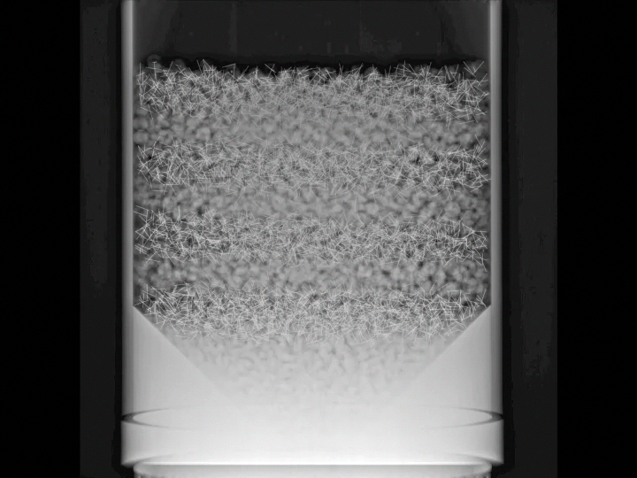
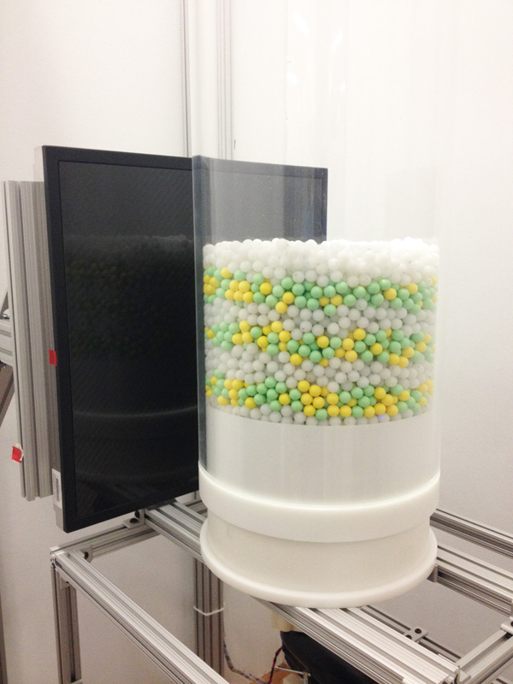

Slide 16
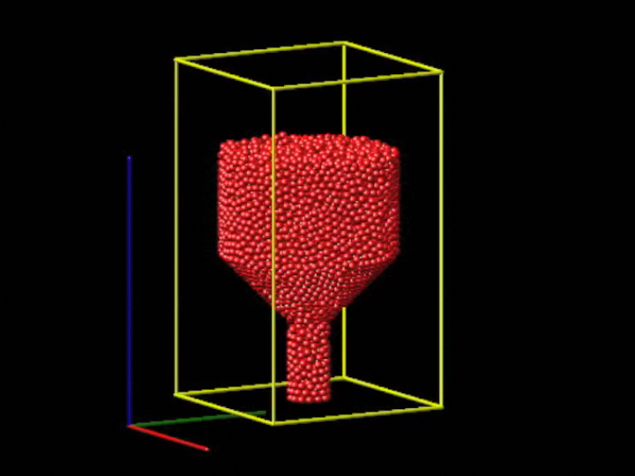
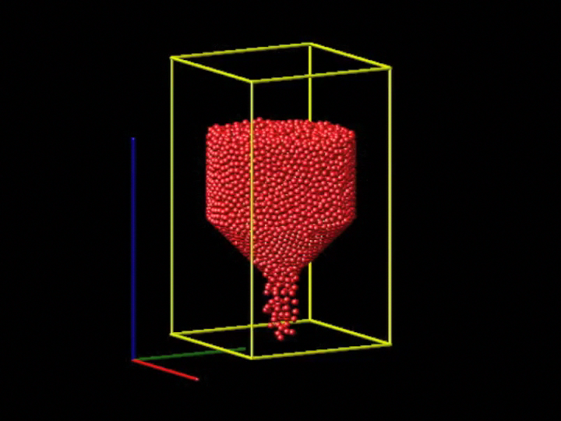
Cylindrical Silo – LAMMPS Simulation
Gravity Drainage
Pebble Recirculation

